Slide 1
Real-time Diagnostic Tools for the Scanning Electron Microscope
Liuchuyao Xu, 2019

Slide 2
The Problem
The SEM takes images.
The images may have disturbances.
The disturbances affect image quality.
Human operators may find it difficult judging how good an image is.
Human operators cannot always take satisfactory images.

Slide 3
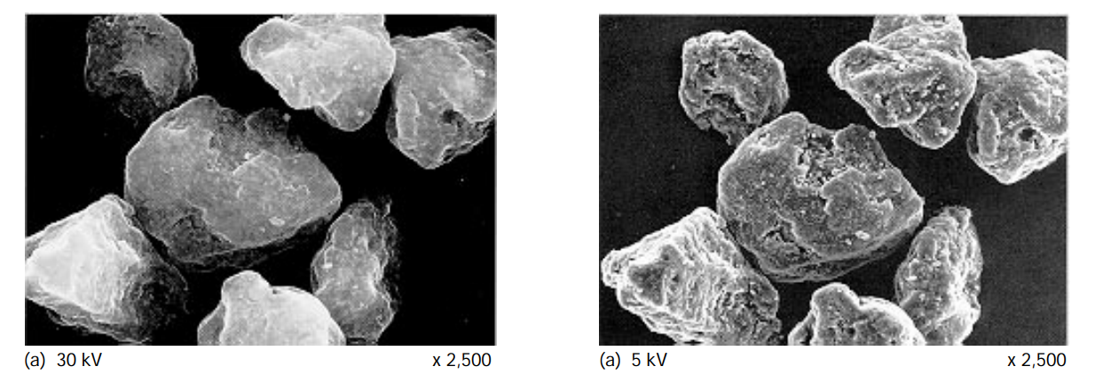
Sample Images

Slide 4
The Solution
A GUI-based software that provides diagnostic information from the images.
Diagnostic information that could be useful:
A histogram.
A measure of brightness.
A measure of sharpness of the images (FFT).
A measure of contrast of the images (variance).

Slide 5
The Bottleneck
The SEM takes images in real-time (10 Hz minimum).
The diagnostic information must be updated in real-time.
Calculation of the diagnostic information takes time.
The software must be easily maintainable, i.e. Python is preferred.
Solution:
Using the Nvidia CUDA Toolkit to perform the calculations on the GPU.

Slide 6
The Progress
Code has been written to utilise CUDA for calculating the FFT.
Code has been written to utilise Qt for deploying a basic GUI.
Results (1024×768 image, Intel i7-7700HQ and Nvidia GTX 1060):
CUDA calculates the FFT 3~6 times faster than Numpy.
A frame rate of ~20 Hz is achieved.

Slide 7
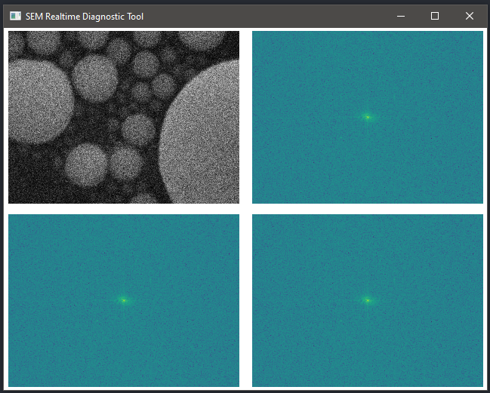
Sample Screenshot

Slide 8
The Future

Slide 9
The Future

